Slide 1
Overview
Introduce Speakers
Proposition L: NOT Relevant
Why This Measure is Needed NOW
What Your Community is Saying
Community Interest vs. Special Interest
Notes:
To replace this picture, just select and delete it. Then use the Insert Picture icon to replace it with one of your own!

Slide 2
Proposition L – Red Herring
Proposition L
“Citizen measures, resulting from signature-gathering effort, are the only measures affected. The requirement does not apply to measures initiated by City officials or a Charter Amendment Review Commission.”
–City Attorney’s analysis
Seven of you say you SUPPORT Modernization/Expansion.
“L” has NOTHING to do with a Special Election for this measure called by City Council.
Red herring cooked up by one special interest.
Act in the community’s interest.

Slide 3
Tourism Supports City – City Should Support Tourism
Tourism revenues: San Diego’s Golden Goose
$200,000,000+ city revenues in 2016
Fastest growing source of revenue
Easiest revenue to GROW
180,000+ San Diegans employed
Modernize/Expand = 10s of millions MORE General Fund revenue for police, fire, parks, libraries, etc. etc. etc.

Slide 4
Urgent Action Needed
Deferred Maintenance Time Bomb
Center facing $60 MILLION maintenance bill.
Cost goes UP each year.
City budget is on the hook.
When and where are you going to find this money?
Lack of upgrades costing us business.
This measure provides TOT to solve problem.

Slide 5
Urgent Action Needed
CITY LOSSES in Past 2 Years
1,161 OPPORTUNITIES LOST.
58 percent due to date or size.
6 MILLION room nights LOST.
TENS OF MILLIONS of TOT General Fund revenues LOST.

Slide 6
Urgent Action Needed
LOSING existing conventions.
Center can no longer accommodate SIX former customers.
145,000 room nights LOST.
Millions in LOST TOT revenues.
Comic-Con NEEDS Modernization/Expansion. So do others.
Estimated economic impact from Biotech convention: $40 MILLION

Slide 7
Urgent Action Needed

Slide 8
Urgent Action Needed
Convention Centers
Total Function Space
+ sq. ft. under construction
Direct competitors are ALL larger and expanding NOW!
We are LOSING the Race and TOT Revenues!
Urgent Action is Needed!

Slide 9
TOT for Jobs, Streets & People WINS THIS NOVEMBER
Our test of a potential measure to raise the tourism occupancy tax (TOT) shows 66.5% currently voting “yes.” Opposition stands at 26.5%. Passage requires two-thirds support.
Q. Some people have been talking about a ballot measure that would raise the tax paid by San Diego’s overnight visitors in order to fund projects and programs in San Diego. It reads: Raises the city of San Diego’s Transient Occupancy Tax (TOT) paid by overnight lodging facilities 1 to 3 percent depending on where the lodging facility is located, and earmarks those funds to modernize and expand the San Diego Convention Center as well as pay for city street repairs and improvements, and programs to reduce homelessness while requiring an annual independent audit of expenditures. If this measure were on the ballot would you vote yes to approve it or no to reject it?
Competitive Edge Survey Results
WINS in November 2017.
NO voters moveable based on “Tourism Support,” which is critical for voter approval.
71% of those surveyed said the fact that lodging and tourism officials are sponsoring the measure to grow SD’s tourism economy, reduce homelessness and fix roads is a good reason to vote for it.
YES votes can extend into the 70s, unlike other tax measures.

Slide 10
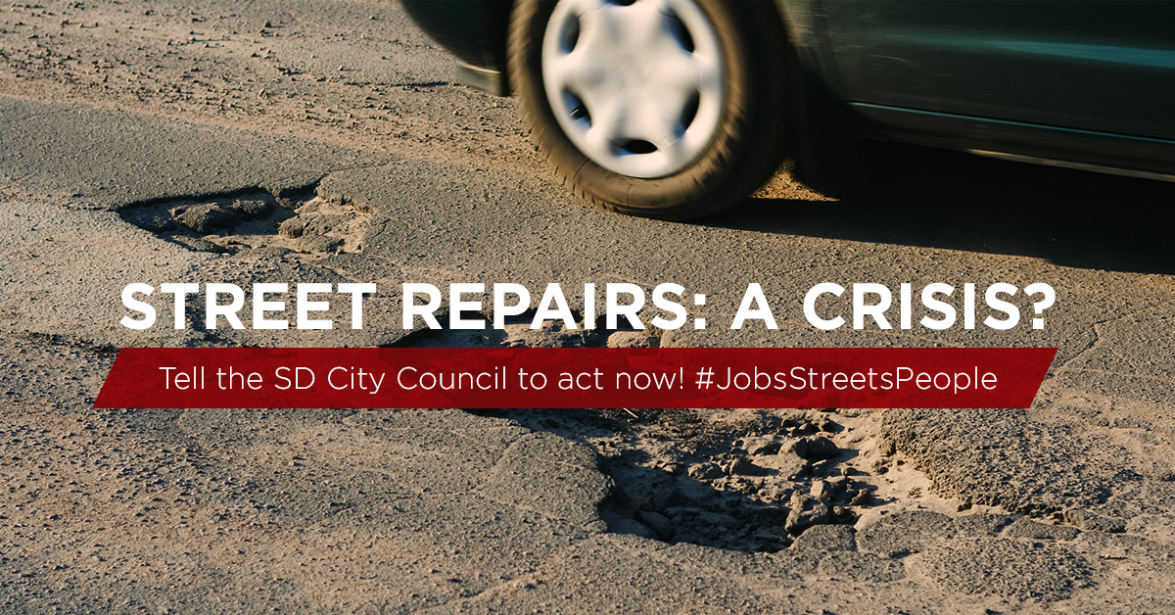
Citywide Street Repairs: #1 Public Concern
Jobs, Streets, People Plan
FIRST dedicated source of street repair funds.
Grows EACH YEAR.
$10 MILLION in Year 1 or $150 MILLION in bonded revenues.
$1 BILLION over 40 years.
SURVEY: How important are city street repairs and improvements to you?
Extremely or Very Important = 86.5%

Slide 11
Homelessness: #2 Public Concern
Jobs, Streets, People Plan
Record high countywide count: 9,100 homeless people.
5,000 homeless in city of San Diego.
One Year INCREASE of people living on city streets: 18%.
FIRST dedicated funding source to reduce homelessness. Grows EACH YEAR.
$10 MILLION in Year 1 or $140 MILLION in bonded revenues.
$1 BILLION over 40 years.
SURVEY: How important is the issue of homelessness in San Diego?
Extremely or Very Important = 80.5%

Slide 12
TOT for Homeless Only – D.O.A.
Flawed survey released last week by labor unions serves up false hope.
Did NOT test same question.
YES: homelessness is an urgent priority.
Tourism industry won’t support taxing our customers if we cannot create new demand drivers that:
Increase revenues for city services in every San Diego neighborhood.
Support the families - 184,000 San Diegans - the tourism industry employs.
Convention Center expansion is NO. 1 priority for new demand drivers.
Jobs, Streets & People Measure = nearly 7,000 permanent JOBS!

Slide 13
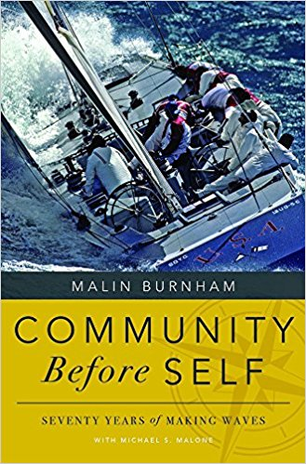
Will You Represent Community Interest or a Special Interest?
Chance to do something NOW about important local problems.
Chance to grow economy and create thousands of jobs.
Chance to put tens of millions more into General Fund.
Chance to raise real money to fix our streets.
Chance to raise real money to reduce homelessness.

Slide 14
Will You Represent Community Interest or a Special Interest?
“It’s a simple test that when applied to small acts of kindness and major redevelopment projects alike can bring clarity to someone’s decision-making.”
“Let’s apply it to one of the biggest redevelopment proposals in town.”
“The San Diego Union-Tribune Editorial Board believes enough San Diegans would support this hotel room tax increase, a jobs generator funded mostly by tourists, because it raises revenue for a convention center expansion and for two of the city’s most pressing problems, improving roads and reducing homelessness.”
Editorial, May 26 2017, The Key to San Diego's Convention Center Expansion
“Longtime San Diego real estate developer and philanthropist Malin Burnham has a mantra: ‘Community before self.’”

Slide 15
Will You Represent Community Interest or a Special Interest?
Waiting is NOT an acceptable option.
Act NOW!
Place Jobs, Streets & People measure on ballot this November.
Do what’s right for San Diego. Put our community first!

